Slide 1

Week 4

Slide 2
What?
Redux is a predictable state container for JavaScript apps

Slide 3
Why?
Managing state in a Single page Javascript is hard and becomes quickly tedious with no clear overview what happens where.

Slide 4
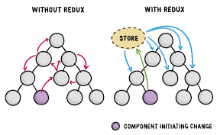

Slide 5
Why?
React provides a great way to create the view side of the application. Redux provides the model/controller part.

Slide 6
Three principles
Single source of truth
State is read-only
Changes are made with pure functions

Slide 7
Architecture

Slide 8
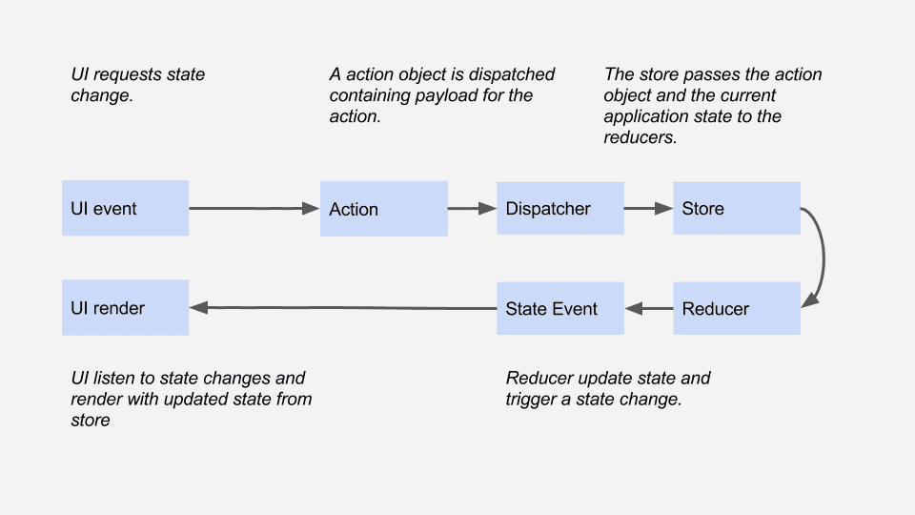
How?

Slide 9
Actions:
payloads of information
describes the fact that something happened
{ type: ADD_TODO, text: 'Build my first Redux app' }

Slide 10
Example
{ type: ADD_TODO, text: 'Build my first Redux app' }

Slide 11
Actions

Slide 12
Reducers:
specifies how the application's state changes in response
Pure function (!)

Slide 13
Example:
const todoApp = (state = initialState, action) => { switch (action.type) { case ADD_TODO: return {todos: [...state.todos,
action.text]} default: return state } }

Slide 14
Reducers

Slide 15
Store
Brings Actions, Reducers together
Following responsibilities:
Holds application state;
Allows access to state via getState();
Allows state to be updated via dispatch(action);

Slide 16
Example
import { createStore } from 'redux' import todoApp from './reducers' import { addTodo } from './actions' let store = createStore(todoApp) store.subscribe(() => console.log(store.getState())) store.dispatch(addTodo('Learn about actions'))

Slide 17
State

Slide 18
Connect to React
import {connect} from "react-redux"; @connect( state => ({ todos: state.todos })) class TodoList extends Component { render() { // this.props.dispatch(someAction()); return <div>{this.props.todos}</div> } }

Slide 19
Connect to React
import { Provider } from 'react-redux' let store = createStore(todoApp) ReactDOM.render( <Provider store={store}> <App /> </Provider>, document.getElementById('todo-app'));

Slide 20
Homework
Open the ./react/week4/README.md
Follow instructions

Slide 21
To Conclude

Slide 22
You should have an understanding about:
How/what/why
Able to use Redux in combination with React
3 principles, actions, state, store, the data flow

Slide 23
Additional information
http://redux.js.org/
https://egghead.io/series/getting-started-with-redux -> Recommended to watch
https://github.com/reactjs/react-redux

